Slide 1
UTILITY-HUB
-Gaurav Thakur
2111981291

Slide 2
IDEA :
Utility Hub offers a mix of riddles, quizzes, music, jokes, and inspiring content to engage users with varied interests..
The project aims to enhance daily routines by providing a daily dose of mental stimulation and positivity.
Users can personalize their experience, choosing activities that align with their preferences for a more tailored engagement.
Beyond activities, Utility Hub is dedicated to promoting positivity, bringing joy, inspiration, and satisfaction to users' lives.

Slide 3
Features/CONCEPT:
Technologies used: HTML, CSS, REACT,REACT-BOOTSTRAP.
Bootstrap Components are used for achieving easy implementation of styling.
The application emphasizes on friendly user interface.
Used React-Router-Dom to Navigation and Routing Proccess.
The Site also provides a Get Inspired Button Which generate a random inspirational quote through use of API.
Site also provides a Riddle me This game.

Slide 4
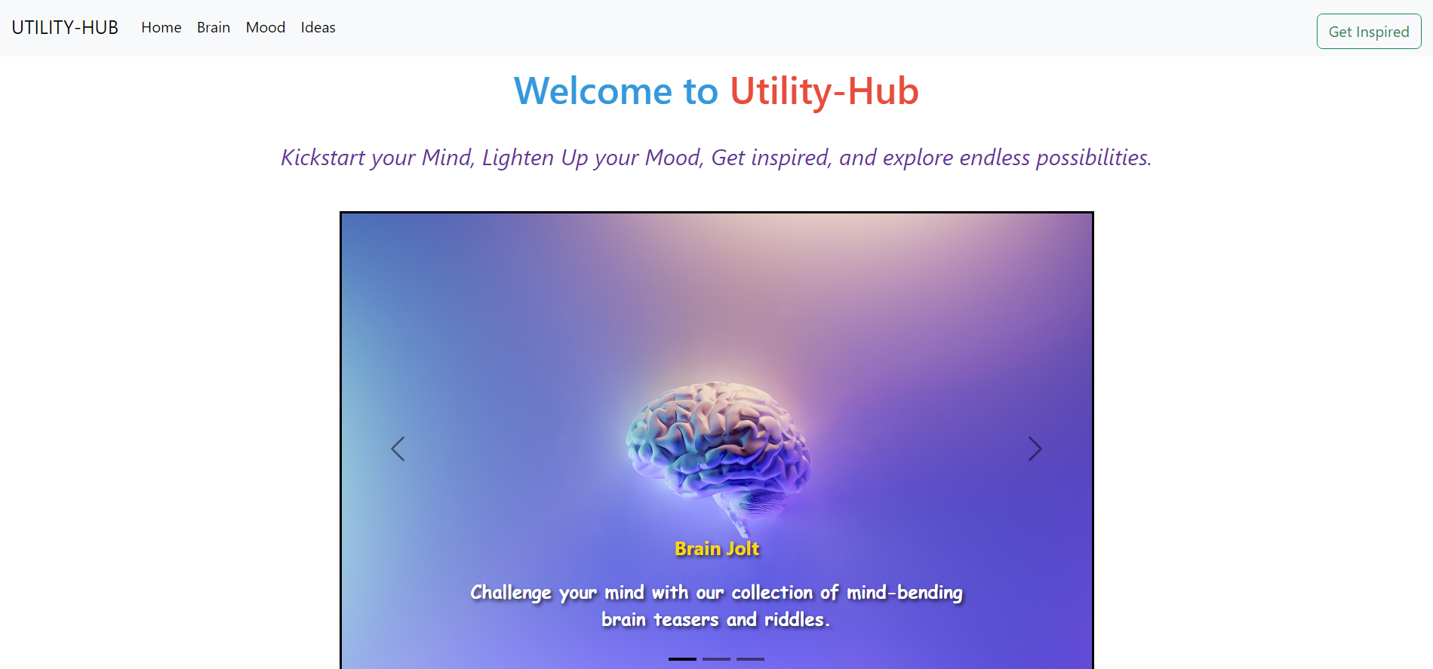
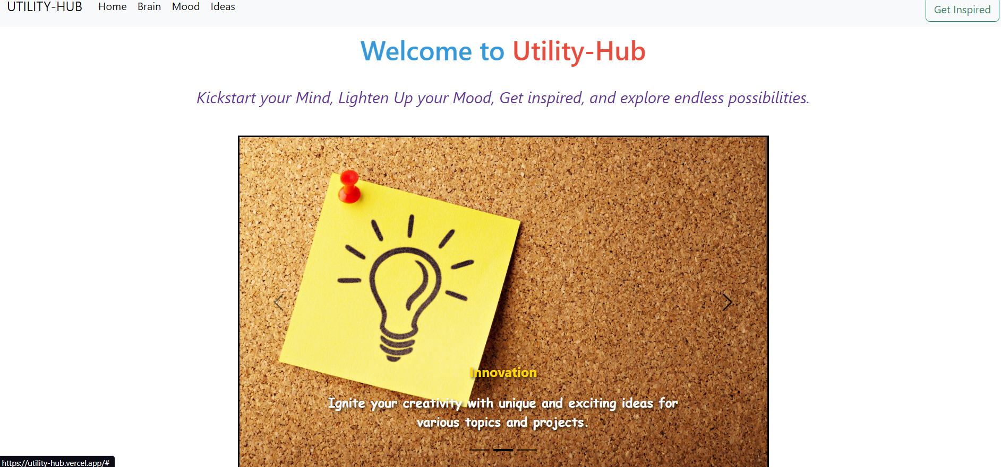
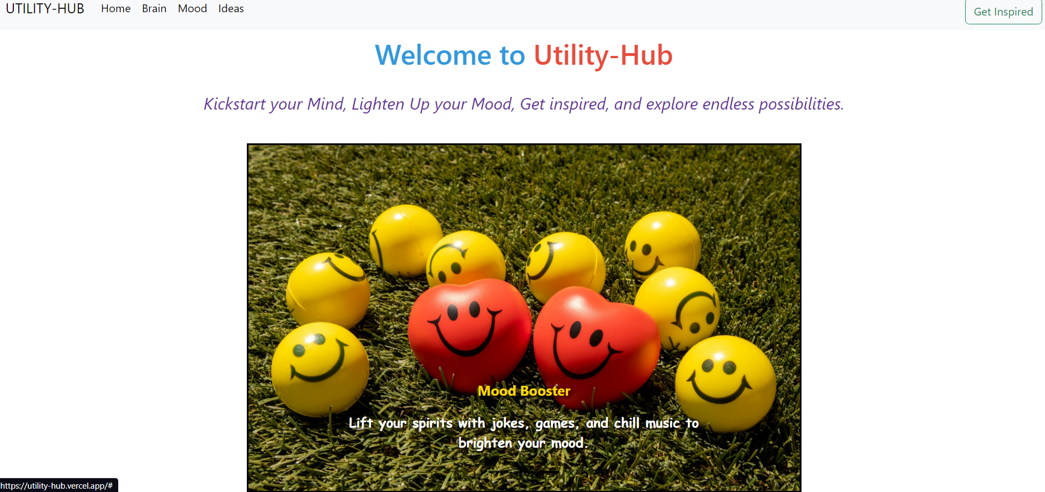
Home Page Screenshots :

Slide 5
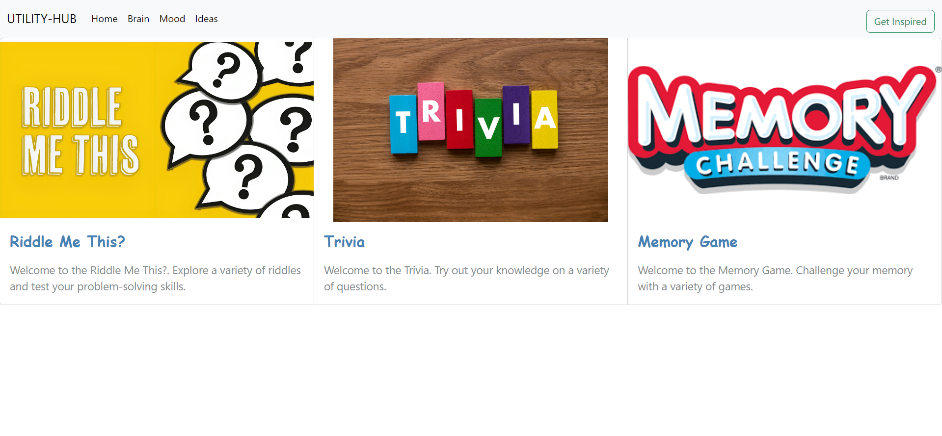
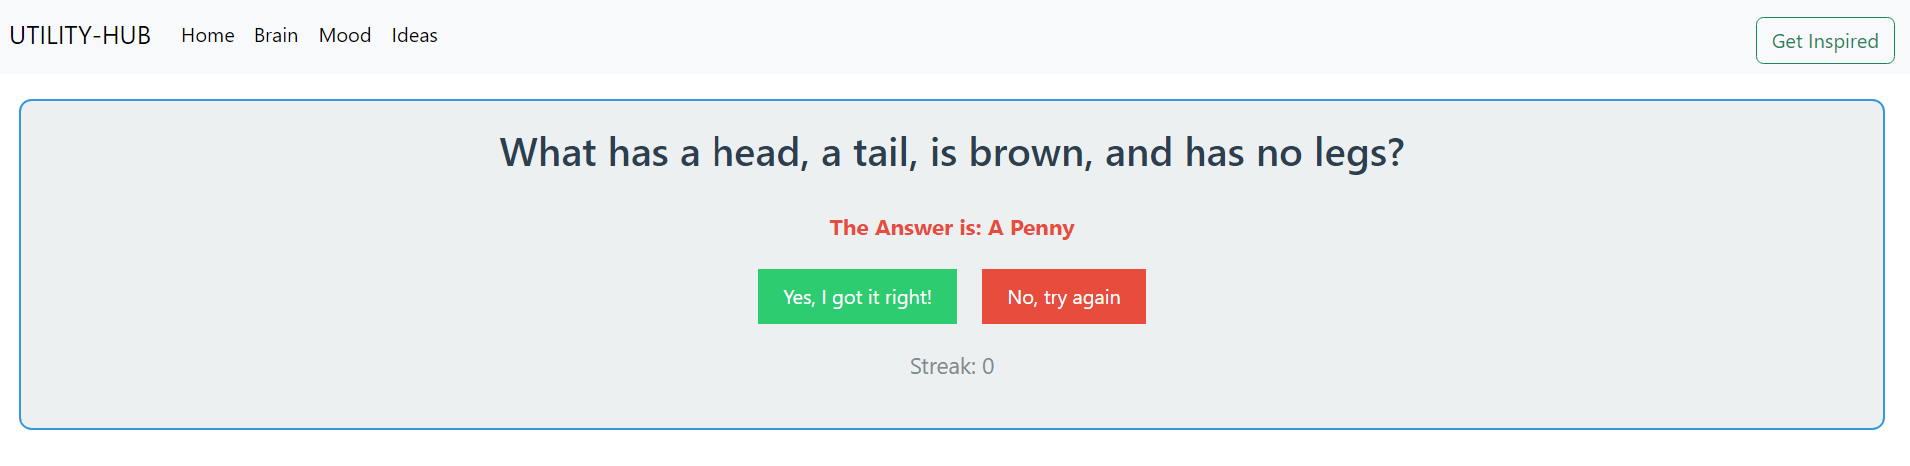
Other Screenshots :

Slide 6
Room for Improvement/DRAWBACKS:
Lack of Events.
More Styling Needed.
Much Content Need to be added.
No Real World Application apart from user enjoyment.
Many features not yet implemented

Slide 7
THANK YOU !

